Slide 1
HOTEL RESERVATION & CANCELLATION PREDICTION
RUTVIKA LATHA BAMMIDI – 119EC0022

Slide 2
PROBLEM STATEMENT
Given a dataset containing data of reservations made by customers in different hotels, build a machine learning model to predict whether the customer cancels his/her hotel reservation or not.

Slide 3
DATA SET
Number of rows = 119390
Number of attributes = 32
Target variable = is_cancelled
Number of independent variables = 31
Number of numeric variables = 12
Number of object variables = 19

Slide 4
INDEPENDENT VARIABLES IN THE DATASET
Hotel
Lead_time
Arrival_date_year
Arrival_date_month
Arrival_date_week_number
Arrival_date_day_of_month
Stays_in_weekend_nights
Stays_in_week_nights
required_car_parking_spaces
customer_type
company
Adults
Children
Babies
Meal
Country
Market_segment
Distribution_channel
reservation_status_date
reservation_status
days_in_waiting_list
is_repeated_guest
previous_cancellations
previous_bookings_not_cancelled
reserved_room_type
assigned_room_type
booking_changes
deposit_type
agent
total_of_special_requests
adr

Slide 5
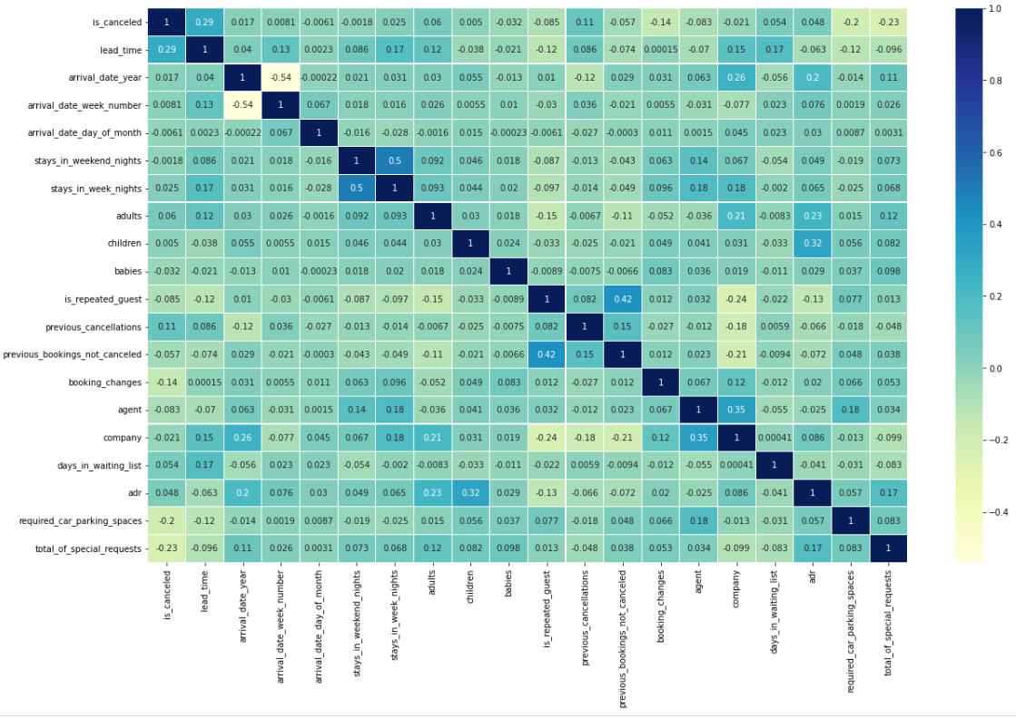
CORRELATION MATRIX

Slide 6

DATA CLEANING
Data Cleaning is the process of preparing data for analysis by weeding out information that is irrelevant or incorrect.

Slide 7
REPLACING NULL/MISSING VALUES
Replacing numerical missing values with Mean/Median
Number of null values in [children] = 4
Number of null values in [agent] = 16340
Number of null values in [company] = 112593

Slide 8
REPLACING NULL/MISSING VALUES
Replacing categorical missing values with MODE
Number of null values in [children] = 4
Number of null values in [agent] = 16340
Number of null values in [company] = 112593

Slide 9
REPLACING DUPLICATE VALUES
Number of duplicate values in the data set = 32013
We will eliminate the 32013 duplicate records from the data set in order to obtain only distinct records. After eliminating the duplicate, we will verify whether or not the duplicates were eliminated from the data set.
Number of rows in the dataset after removing duplicates = 87377

Slide 10
ENCODING CATEGORIAL DATA
Encoding categorical data is a process of converting categorical data into integer format so that the data with converted categorical values can be provided to the models to give and improve the predictions.
Utilizing the label encoding method is one way to encode categorical values. A column’s values are simply changed to numbers as part of label encoding.
When the variables in the data are ordinal, this type of encoding is used. Ordinal encoding turns each label into an integer value, and the encoded data represents the order of labels.

Slide 11
ENCODING CATEGORIAL DATA
Categorical variables in our data set –
Hotel
arrival_date_month
meal
country
Market_segment
distribution_channel
reserved_room_type
assigned_room_type
deposit_type
customer_type
reservation_status
reservation_status_date

Slide 12
TRAINING THE MODEL
• Size of training data = 75%
• Size of testing data = 25%

Slide 13
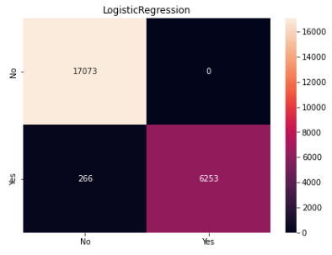
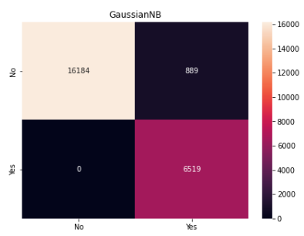
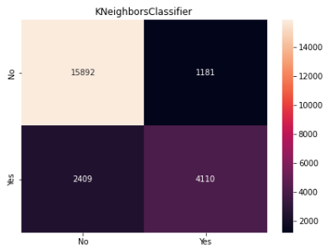
CONFUSION MATRIX
Logistic Regression
Gaussian Naïve Bayes
KNeighbors Classifiers

Slide 14
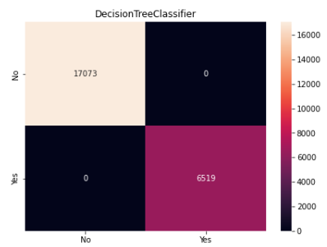
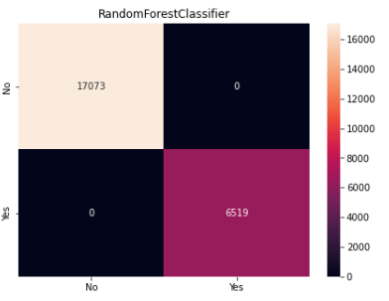
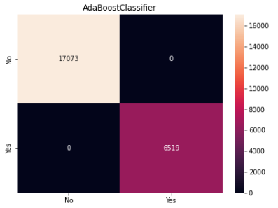
CONFUSION MATRIX
Decision Tree Classifier
Random Forest Classifier
Ada Boost Classifier

Slide 15
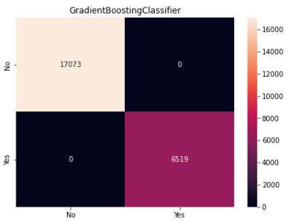
CONFUSION MATRIX
Gradient Boosting Classifier

Slide 16
ACCURACY USING VARIOUS CLASSIFIERS
CLASSIFIERS | TRAINING ACCURANCY | TESTING ACCURACY
Logistic Regression | 0.9882417496276554 | 0.98872499152255
Gaussian Naive Bayes | 0.9610566747667947 | 0.9623177348253645
KNeighbors Classifier | 0.919463823783021 | 0.8478297728043405
Decision Tree Classifier | 1.0 | 1.0
Random Forest Classifier | 1.0 | 1.0
Ada Boost Classifier | 1.0 | 1.0
Gradient Boosting Classifier | 1.0 | 1.0

Slide 17
CONCLUSION
The highest accuracy in this problem is obtained using the Decision Tree Classifier, Random Forest Classifier, Ada Boost Classifier, and Gradient Boosting Classifier
Highest accuracy = 100%

Slide 18
THANK YOU

